Slide 1
Texture analysis

Slide 2
What is Texture?
a feature used to partition images into regions of interest and to classify those regions
provides information in the spatial arrangement of colours or intensities in an image
characterized by the spatial distribution of intensity levels in a neighbourhood
repeating pattern of local variations in image intensity
cannot be defined for a point

Slide 3
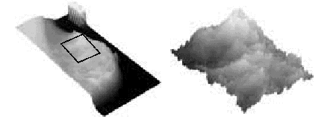
What is Texture? (continued)
• Texture is a repeating pattern of local variations in image intensity:

Slide 4

What is Texture? (continued)
For example, an image has a 50% black and 50% white distribution of pixels.
Three different images with the same intensity distribution, but with different textures.

Slide 5
Texture
Texture consists of texture primitives or texture elements, sometimes called texels.
– Texture can be described as fine, coarse, grained, smooth, etc.
– Such features are found in the tone and structure of a texture.
– Tone is based on pixel intensity properties in the texel,
while structure represents the spatial relationship between texels.
– If texels are small and tonal differences between texels are large a fine texture results.
– If texels are large and consist of several pixels, a coarse texture results.

Slide 6
Texture Analysis
Two primary issues in texture analysis:
- texture classification
- texture segmentation
Texture classification is concerned with identifying a given textured region from a given set of texture classes.
Each of these regions has unique texture characteristics.
Statistical methods are extensively used.
(e.g. GLCM, contrast, entropy, homogeneity)
Texture segmentation is concerned with automatically determining the boundaries between various texture regions in an image.

Slide 7
Defining Texture
There are three approaches to defining exactly what texture is:
Structural : texture is a set of primitive texels in some regular or repeated relationship.
Statistical : texture is a quantitative measure of the arrangement of intensities in a region.
This set of measurements is called a feature vector.
Modeling : texture modeling techniques involve constructing models to specify textures.

Slide 8
Defining Texture (2)
• Statistical methods are particularly useful when the texture primitives are small, resulting in microtextures.
• When the size of the texture primitive is large, first determine the shape and properties of the basic primitive and the rules which govern the placement of these primitives, forming macrotextures.

Slide 9
Gray Level Co-occurrence
The statistical measures described so far are easy to calculate, but do not provide any information about the repeating nature of texture.
A gray level co-occurrence matrix (GLCM)
contains information about the positions of pixels having similar gray level values.

Slide 10
GLCM
A co-occurrence matrix is a two-dimensional array, P, in which both the rows and the columns represent a set of possible image values.
A GLCM Pd[i,j] is defined by first specifying a displacement vector d=(dx,dy) and counting all pairs of pixels separated by d having gray levels i and j.

Slide 11
GLCM
The GLCM is defined by:
– where nij is the number of occurrences of the pixel
values (i,j) lying at distance d in the image.
– The co-occurrence matrix Pd has dimension n× n,
where n is the number of gray levels in the image.

Slide 12
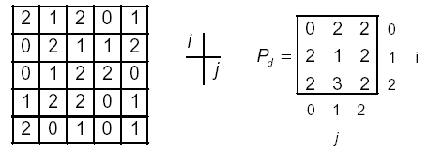
GLCM
For example, if d=(1,1)
there are 16 pairs of pixels in the image which satisfy
this spatial separation. Since there are only three gray
levels, P[i,j] is a 3×3 matrix.

Slide 13
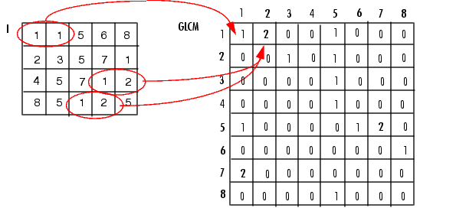
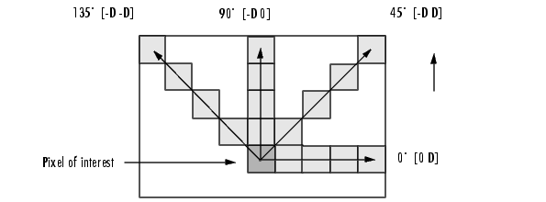

Slide 14
GLCM
Algorithm:
• Count all pairs of pixels in which the first pixel has a value i, and its matching pair displaced from the first pixel by d has a value of j.
• This count is entered in the i^{th} row and j^{th} column of the matrix P_{d}[i,j]
• Note that P_{d}[i,j] is not symmetric, since the number of pairs of pixels having gray levels [i,j] does not necessarily equal the number of pixel pairs having gray levels [j,i].

Slide 15
Normalized GLCM
• The elements of Pd[i,j] can be normalized by dividing
each entry by the total number of pixel pairs.
Normalized GLCM N[i,j], defined by:
which normalizes the co-occurrence values to lie between 0 and 1, and allows them to be thought of as probabilities.

Slide 16
Numeric Features of GLCM
• Gray level co-occurrence matrices capture properties of a texture but they are not directly useful for further analysis, such as the comparison of two textures.
• Numeric features are computed from the co-occurrence matrix that can be used to represent the texture more compactly.

Slide 17
Quantitative Texture Measures
Numeric quantities or statistics that describe a texture can be calculated from the intensities (or colors) themselves
One problem with deriving texture measures from co-occurrence matrices is how to choose the displacement vector d.
The choice of the displacement vector is an important parameter in the definition of the GLCM.
Occasionally the GLCM is computed from several values of d and the one which maximizes a statistical measure computed from P[i,j] is used.
Zucker and Terzopoulos used a χ² measure to select the values of d that have the most structure; i.e. to maximize the value:

Slide 18
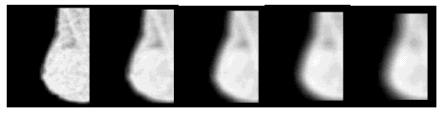
Windowing
• Algorithms for texture analysis are applied to an image in a series of windows of size w, each centered on a pixel (i,j).
• The value of the resulting statistical measure are assigned to the position (i,j) in the new pixel.

Slide 19
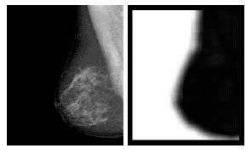
Maximum Probability
• This is simply the largest entry in the matrix, and corresponds to the strongest response. This could be the maximum in any of the matrices or the maximum overall.
• Maximum probability with w=21, and d=(2,2)

Slide 20
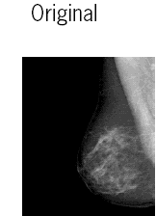
Range
One of the simplest of the texture operators is the range or difference between maximum and minimum intensity values in a neighborhood.
The range operator converts the original image to one in which brightness represents texture.
Original
Range operator

Slide 21
Variance
Another texture estimator is the variance or sum of
difference between intensity of the central pixel and its neighborhood.
Original
Variance

Slide 22
Moments
• The order k element difference moment can be defined as:
• This descriptor has small values in cases where the largest elements in Pare along the principal diagonal. The opposite effect can be achieved using the inverse moment.

Slide 23
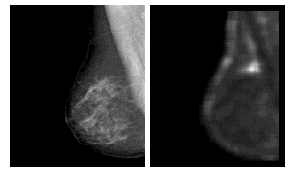
Moments
• Moments with w=21, and d=(2,2)

Slide 24
Contrast
• Contrast is a measure of the local variations present in an image.
• If there is a large amount of variation in an image the P[i,j]’s will be concentrated away from the main diagonal and contrast will be high (typically k=2, n=1).

Slide 25
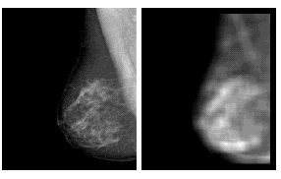
Contrast
• Contrast with w=21, and d=(2,2)

Slide 26
Homogeneity
•A homogeneous image will result in a co-occurrence matrix with a combination of high and low P[i,j]’s.
– Where the range of gray levels is small the P[i,j] will
tend to be clustered around the main diagonal.
– A heterogeneous image will result in an even spread
of P[i,j]’s.

Slide 27
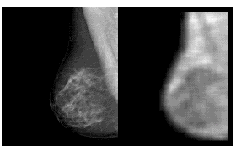
Homogeneity
• Homogeneity with w=21, and d=(2,2)

Slide 28
Entropy
•Entropy is a measure of information content. It measures the randomness of intensity distribution.
– Such a matrix corresponds to an image in which there are no preferred gray level pairs for the distance vector d.
– Entropy is highest when all entries in P[i,j] are of similar magnitude, and small when the entries in P[i,j] are unequal.

Slide 29
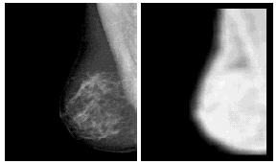
Entropy
• Entropy with w=21, and d=(2,2)

Slide 30
Correlation
• Correlation is a measure of image linearity
• Correlation will be high if an image contains a
considerable amount of linear structure.

Slide 31
Energy
• One approach to generating texture features is to use local kernels to detect various types of texture.
• After the convolution with the specified kernel, the
texture energy measure (TEM) is computed by summing
the absolute values in a local neighborhood:
• If n kernels are applied, the result is an n-dimensional
feature vector at each pixel of the image being analyzed.

Slide 32
Gray-level Difference Statistics
• Gray-level differences are based on absolute differences between pairs of gray-levels.
• The gray-level differences are contained in a 256-element vector, and are computed by taking the absolute differences of all possible pairs of gray levels distance d apart at angle Θ, and counting the number of times the difference is 0,1,…,255
• Let d=(dx,dy) be the displacement vector between two image pixels, and g(d) the gray-level difference at distance d.
• pg(g,d) is the histogram of the gray-level differences at the specific distance, d. One distinct histogram exists for each distance d.

Slide 33
Gray-level Difference Statistics (2)
• The difference statistics are then normalized by dividing each element of the vector by the number of possible pixel pairs.
• Several texture measures can be extracted from the histogram of gray-level differences:
• Mean:
– Small mean values µd indicate coarse texture having a grain size equal to or larger than the magnitude of the displacement vector.
• Entropy:
– This is a measure of the homogeneity of the histogram. It is maximized for uniform histograms.

Slide 34
Gray-level Difference Statistics (3)
• Variance:
– The variance is a measure of the dispersion of the gray-level differences at a certain distance, d.
• Contrast:

Slide 35
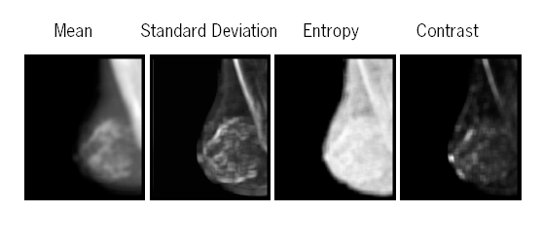
Gray-level Difference Statistics (4)
Some experimental results:

Slide 36
Edges and Texture
It should be possible to locate the edges that result from the intensity transitions along the boundary of the texture.
Since a texture will have large numbers of texels, there should be a property of the edge pixels that can be used to characterise the texture.
• a set of common directions
• a measure of the local density of the edge pixels
Compute the co-occurrence matrix of an edge-enhanced image.

Slide 37
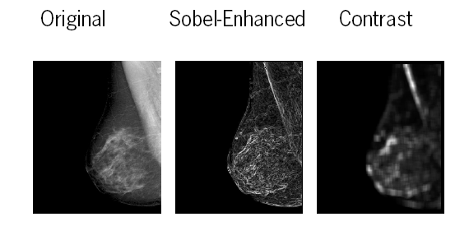
Edges and Texture

Slide 38
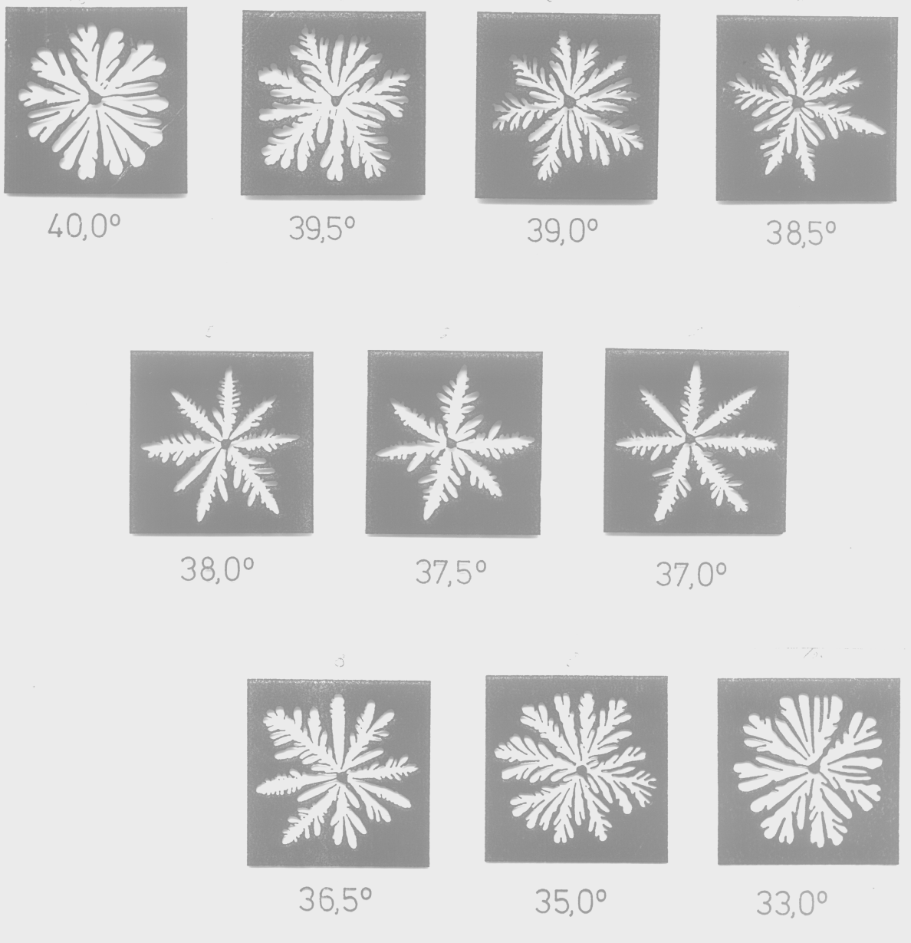
Liquid Crystals Textures
Notes:
Patterns were recorded by video camera and the signals were digitized with a resolution of 256 x 256 on 8 bit gray scale.
The first step of image recognition procedure is image enhancement by temporary filters.
There can be observed for certain characteristic of texels features as a function of temperature are reflected by the location of extreme at T = 37,5⁰C.
The texel information of an image with a more complete respect of texture characteristics.

Slide 39
Energy vs. Temperature

Slide 40
Entropy vs. Temperature

Slide 41
Correlation vs. Temperature

Slide 42
Homogeneity vs. Temperature

Slide 43
Inertia vs. Temperature

Slide 44
Haralick Texture Operator
• Haralick et al. suggested a set of 14 textural features which can be extracted from the co-occurrence matrix, and which contain information about image textural characteristics such as homogeneity, linearity, and contrast.
Haralick, R.M., K. Shanmugam, and I. Dinstein, "Textural features for image classification” IEEE Transactions on Systems, Man and Cybernetics: pp. 610-621. 1973.

